Slide 1















Network Simulation Final Project
Presented by Nguyen Quang Anh - Group 6 Leader - BA10-002

Slide 2
Design
01.
Table of Contents
02.
Implementation
Data Collection & Report
03.

Slide 3

Problems
In recent years, wireless network technology has developed rapidly and covered almost all countries in the world, however, the increase in the number of such network devices has raised many problems related to the optimization of the transmission
So in this final project, we will use ns-3.39
to simulate an ad-hoc wireless network
utilizing the CSMA/CA protocol without RTS/CTS
to determine the efficiency of RTS/CTS

Slide 4
Design

Slide 5
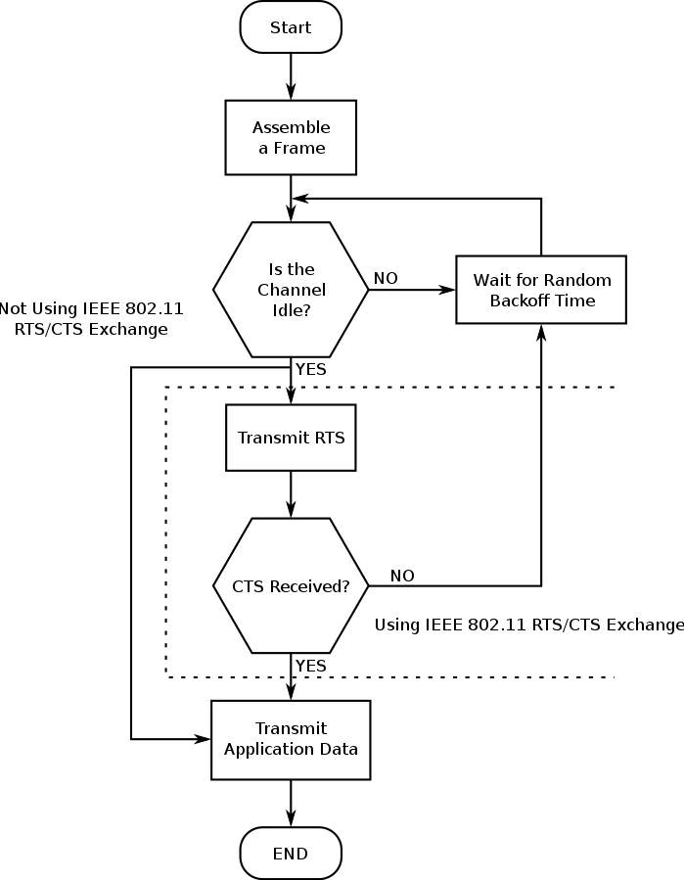
Design
Notes:
The labwork requires evaluating the performance of the CSMA/CA protocol without the RTS/CTS (Request-to-Send/Clear-to-Send) scheme. The number of nodes within the communication range is to be increased from 2 to 30 nodes.

Slide 6
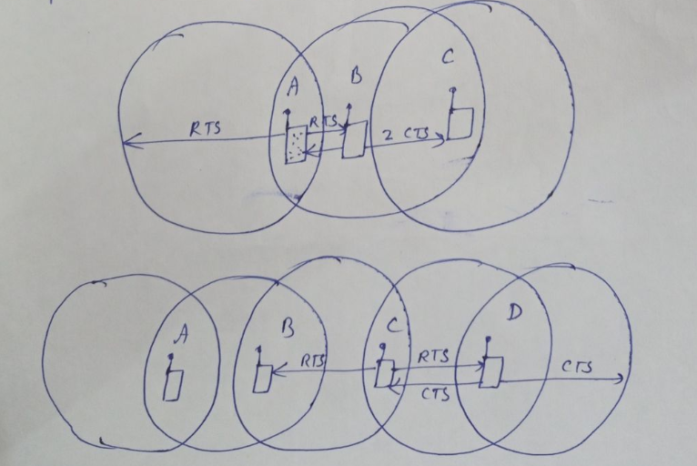
Implementation
All nodes within range of the sender, receiver or both, to not transmit for the duration of the main transmission. Implementation of RTS/CTS help to partially solve the hidden node that is often found in wireless neither.

Slide 7
Setup Application

Slide 8
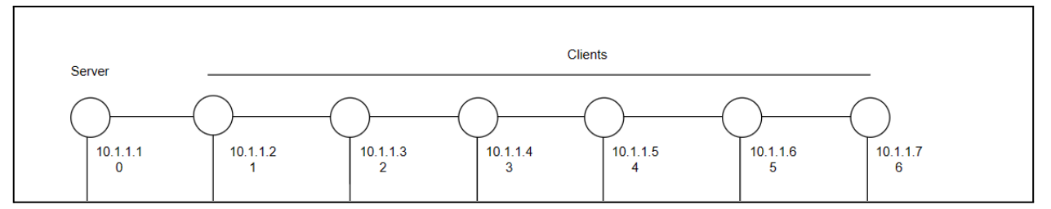
1 node is a server (default is the 1st node)
The rest are clients
All clients will simultaneously send packets to the server

Slide 9
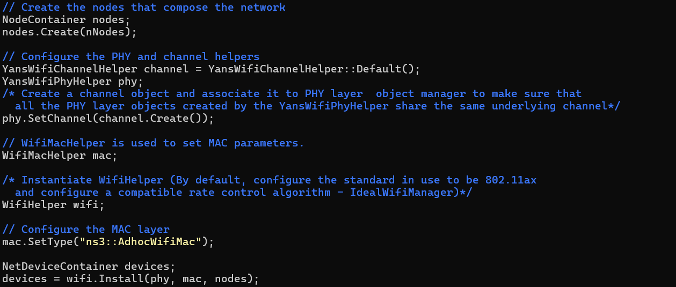
Disable RTS/CTS
Create nodes and install Wifi model
Notes:
Configure MAC layer using “ns3::AdhocWifiMac” to make the network works in ad-hoc mode

Slide 10
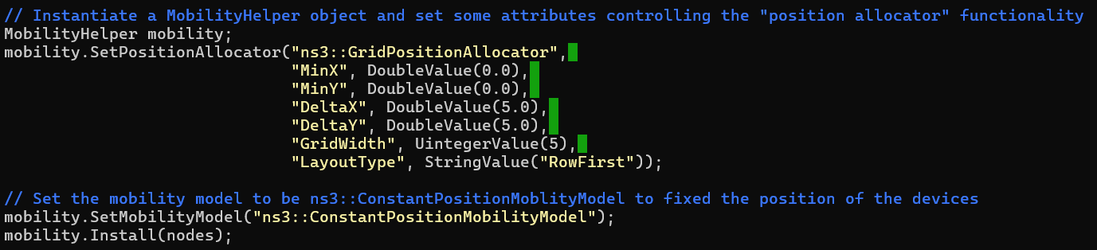
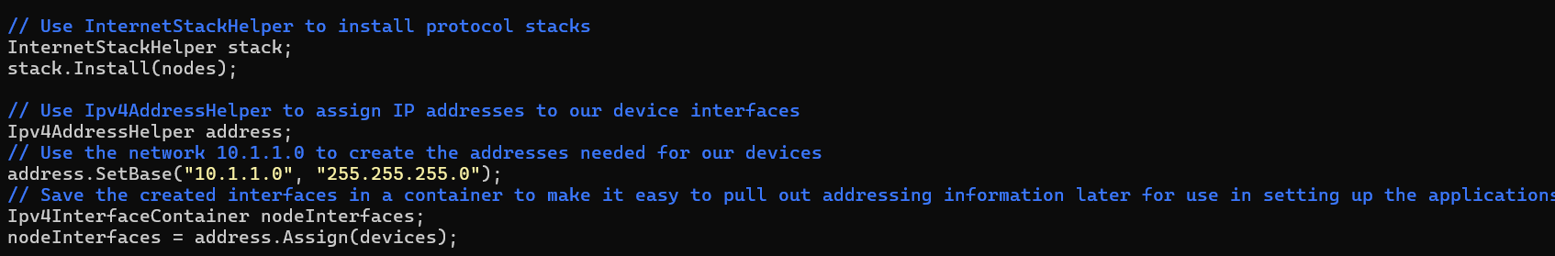
Source code to install the mobility model
Install Internet Stack

Slide 11
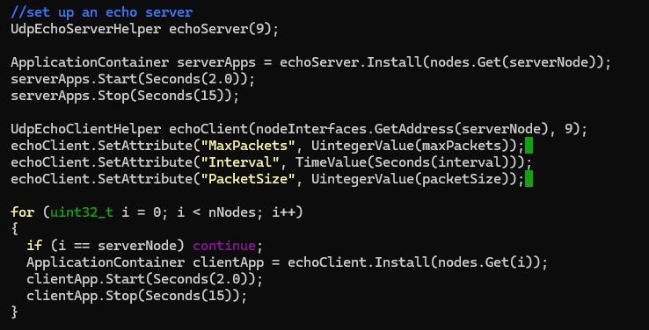
Set up an echo server
Notes:
Firstly, we create a UdpEchoServerHelper and provide the server port number.
Secondly, instantiate the server on the chosen server node.
Create a UdpEchoClientHelper and provide the remote address and port. After, we install the client on every other node except the serverNode.

Slide 12
Data Collection & Report

Slide 13
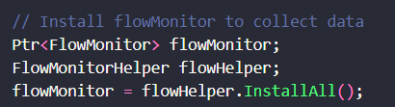
Collect data
Notes:
We use flowMonitor to collect data

Slide 14
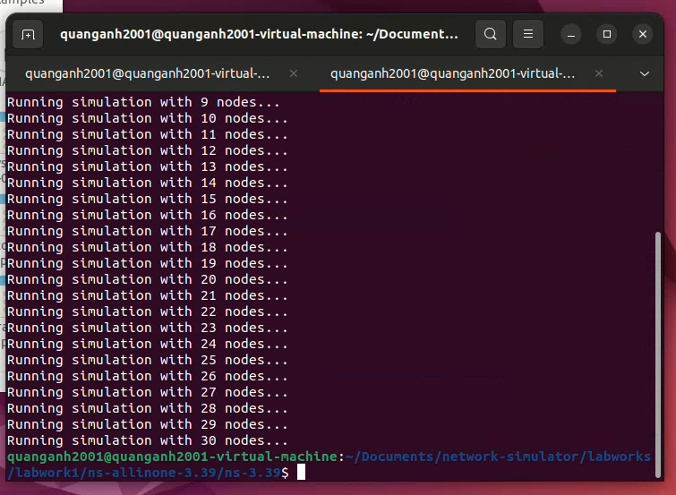
Running simulation

Slide 15
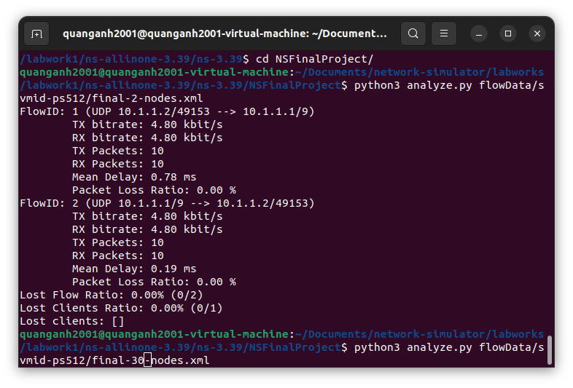
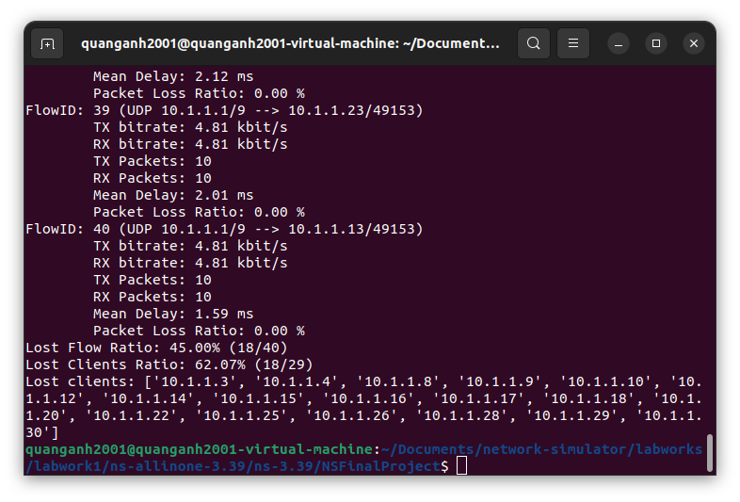
Analyze data
Notes:
Data from Flow Monitor: Data is stored in flows that contain all data about packets sent by a particular host to another
Data from the flows contains a lot of interesting information such as
The time the first and last packet is transmitted and received
The total delay
The total bytes and packets transmitted and received
All packets sent by some clients are completely lost.

Slide 16
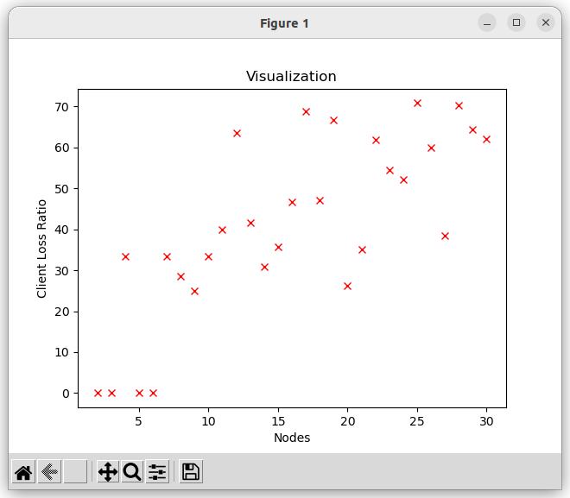
Summarize data
Notes:
When the number of nodes increases, the ratio of lost client also increases

Slide 17
Conclusions
Data collision is more likely to occur in ad-hoc wireless networks if all devices are linked to one another if RTS/CTS is disabled. In light of this, as the number of nodes rises, so do the number of clients and the volume of packets being sent. More collisions occur, and more packets are lost as a result.

Slide 18
Thank you for presentation!

